Slide 1
Brief on the Speaker
Mr. Chandrasekhar S Certified HAZOP Leader Certified Functional Safety Expert Certified Fire and Gas Practitioner TUV Risktec Assessed Specialism – Oil & Gas QRA
Holds M. Tech. from IIT Bombay, India with Major in Control & Instrumentation
Seasoned Oil & Gas engineering professional, with over 36 years of experience in Engineering & Operations of Oil & Gas Industry
Operational Excellence Leader with proven record of enhancing Operational work processes. Successfully executed a very complex Digital Oil Field projects. Prime contributor to Engineering Standards for Functional Safety, Alarm Management & Fire and Gas Mapping, Control & Shutdown valves, Rotating Equipment, and recognized contributor to international Best Practices. Competency Development Leader with recognized contributions to young engineers’ training and played leading role in numerous HAZOP, HAZID, SIL, CHAZOP, PHSER, Alarm Rationalization and Fire & Gas Mapping. Delivered numerous professional training courses.
Worked for 15 years with ONGC, and with Kuwait Oil Company for 23 years as as Senior Specialist

Slide 2
THE IMPORTANCE OF SAFETY INSTRUMENTED SYSTEM IN THE PROCESS INDUSTRY

Slide 3
Engineering Ethics
Engineering ethics – to protect Health, Safety and Environment of people (in their work)
An engineer designs a bridge that collapses causing multiple injuries.
A dam collapse causing multiple fatalities of people living under the dam.
In New Delhi, a high rise building caught fire. Residents tried to escape using stairs. The stairs had many electrical cables that were burning and the severe suffocation from smoke prevented people from using the stairs, causing avoidable fatalities.
Gas has leaked from a high pressure pipe in a factory. Even though gas detectors exist, they were either unsuitable to the type of gas to detect, or they were not adequate to cover all the areas. The leakage continued un-noticed and eventually big gas cloud formed which ignited and caused injury to several workers.
All the above incidents caused injuries or fatalities that were preventable!

Slide 4
Preventing Injuries and Protecting People
Everyday, Engineers Plan, Specify, Calculate, Design, Test or Maintain a system.
It is the Engineer’s duty to ensure that they exercise due diligence in their work – to ensure that there is no hazardous (i.e., potential to harm) failure of the system they design.
Failures may cause ill-health, injuries / fatalities (Safety) or damage to Environment.
Every Engineer must take care of HSE.
Source of the pic is unknown

Slide 5
Preventing Injuries and Protecting People
A rocket is designed by hundreds of Engineers with all due care. After launching, it exploded, causing deaths of all Astronauts. Reason was later found to be a wrong gasket that failed to separate the O2 and H2 tanks of the rocket.
An anti-missile is designed and put to battle use to defend a nation. When enemy fired missiles, the anti-missile failed to interrupt the incoming missiles causing massive damage to the missile facility with multiple fatalities. Reason was found to be a faulty program code.
Everything can fail!.

Slide 6
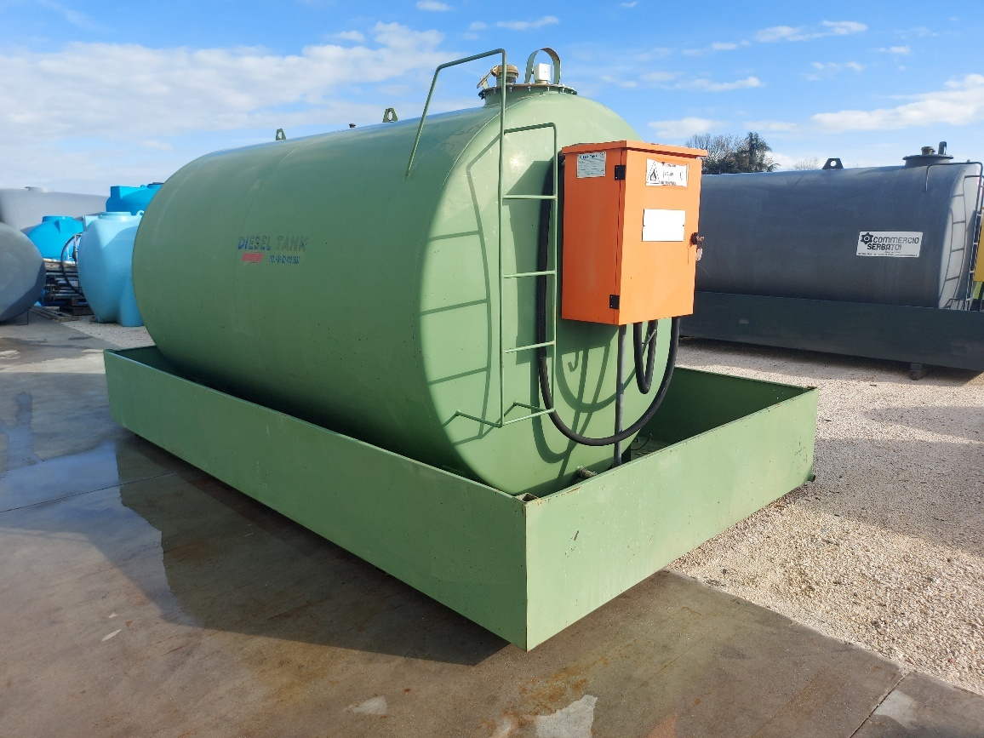
Preventing Injuries and Protecting People
If everything can fail, how does an Engineer take care of HSE in his designs?
Ans: By ensuring that multiple layers of protection exists and functions when needed.
E.g., A Diesel tank is provided with a wall (bund) around it, so that when the tank’s level control fails, the oil will overflow but will be contained within the bund.
Everything can fail, but damage can be controlled by using multiple Layers of Protection!.

Slide 7
Layers of Protection
Question: If multiple devices are utilized, will they not create more failures (because now we have more things to fail).
Answer: True! But they may not fail at the same time. Hence overall reliability is enhanced by ensuring at least one device / equipment functioning “when needed”.
E.g., Driver of a car has primary responsibility to ensure safety while reversing his car. However, the car is provided with sensors to warn him of danger, in case the car is going to touch something. It is highly unlikely that the sensors, even though they can fail, will not function at the same time as the driver making wrong judgement.
For many operations in a factory, the human operator is the primary defense to control, just as the driver has primary responsibility.

Slide 8
Layers of Protection
Which of these are Hazardous and which one’s are Non-Hazardous
Fire
Water
Earth
Liquified Petroleum Gas (LPG)
Gasoline
Air
Walking on the pavement
Crossing the road at a pedestrian crossing
Crossing the road at a non-pedestrian crossing
Cooking
Summary: A Hazard is not the Material. It is a property of a given material that can cause harm to Personnel or to Plant. In order to avoid harm from the Hazard, it is necessary to “Manage” the Operation with the Material. We do not eliminate the material itself, we try to eliminate the Hazard.

Slide 9
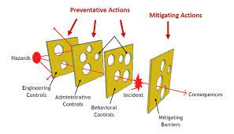
Layers of Protection – Swiss Cheese Model
.
Source: Nasa, USA
Source: umich.edu

Slide 10
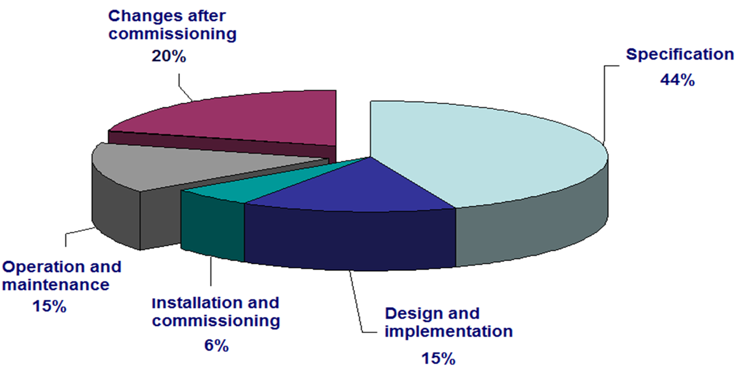
Why industrial accidents happen
.

Slide 11
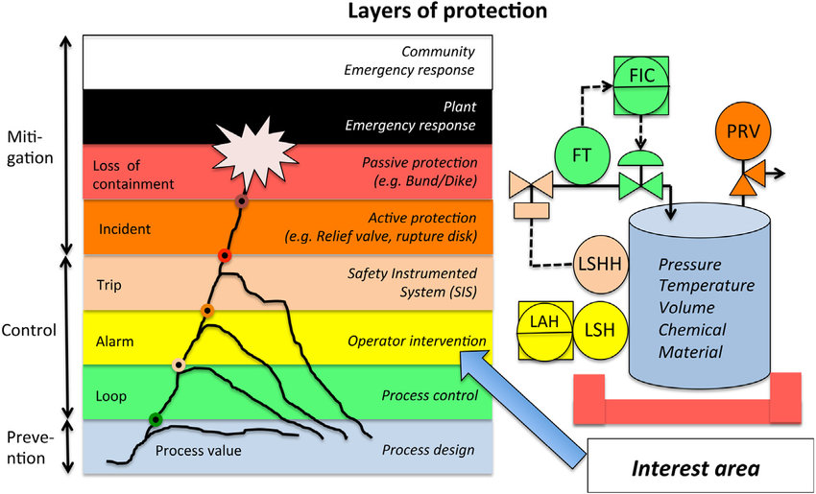
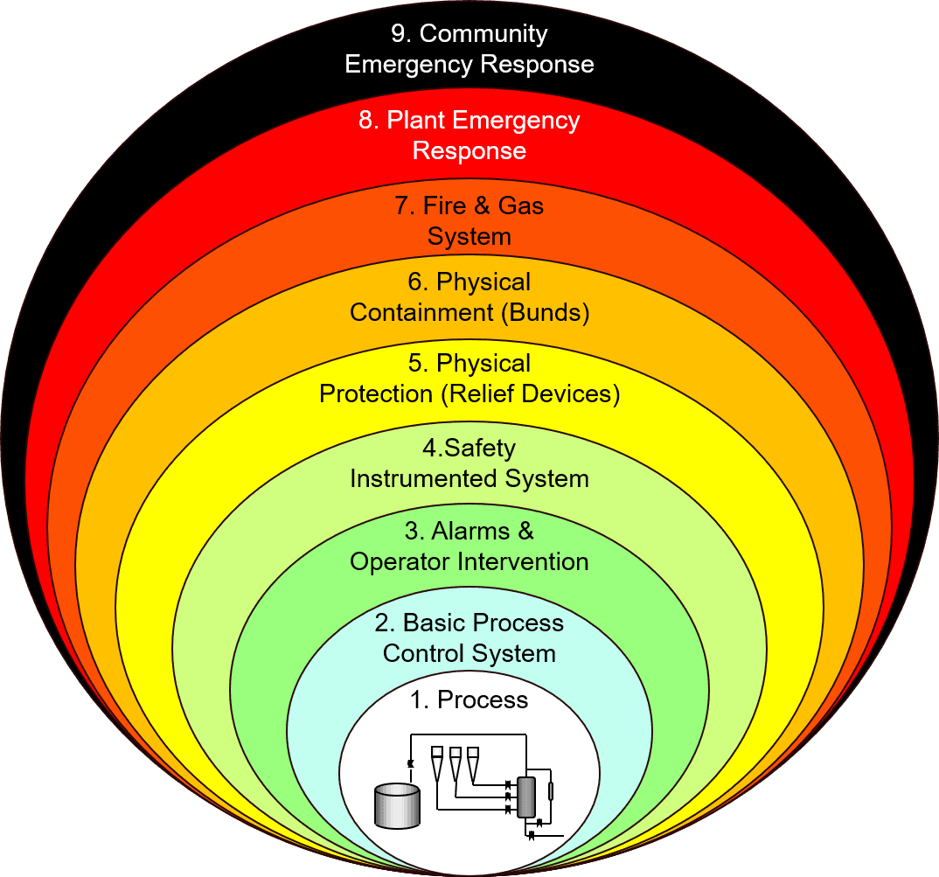
How to Analyze Risk Reduction – Layers of Protection
Layer of Protection Analysis is fundamental to achieving a risk reduction Target
Figure from: Stauffer, T., Sands, N., Dunn, D., 2000. Alarm management and isa-18 a journey, not a
destination. In: Texas A & M Instrumentation Symposium.
After Operator, only Safety Shutdown System can protect the plant
Figure from: nistinstitute.com

Slide 12
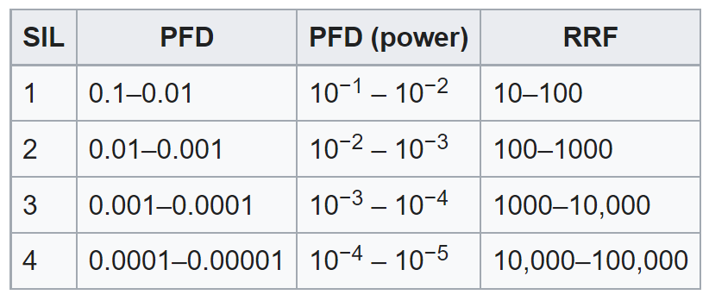
Functional Safety - Safety Integrity Level (SIL)
Safety integrity level (SILs) defines the maximum number of times that a system built to a particular integrity level would be expected to fail in a given period of time. SIL should be considered as a performance level of Functional Safety.
DCS Control & Alarm / Operator action RRF: 10
Emergency Shutdown (ESD) RRF: 10 to 10000
Pressure Safety Valve (PSV) RRF: 100
Dyke / Tank overflow line RRF: 100
RRF: Risk Reduction Factor. It is the Factor of (usually Likelihood or frequency) reduction of an Event.
PFD=1/RRF
A system or element that may fail (dangerously) once in ten years is described to have a “Probability of Failure” of 1/10 or 0.1. If this failure happens when the system or element is not required to function, it may result in some shutdown but may not create harm. What is important is the chance of failing “when required”. This chance of failing when required is called “Probability of Failure on Demand” or PFD.

Slide 13
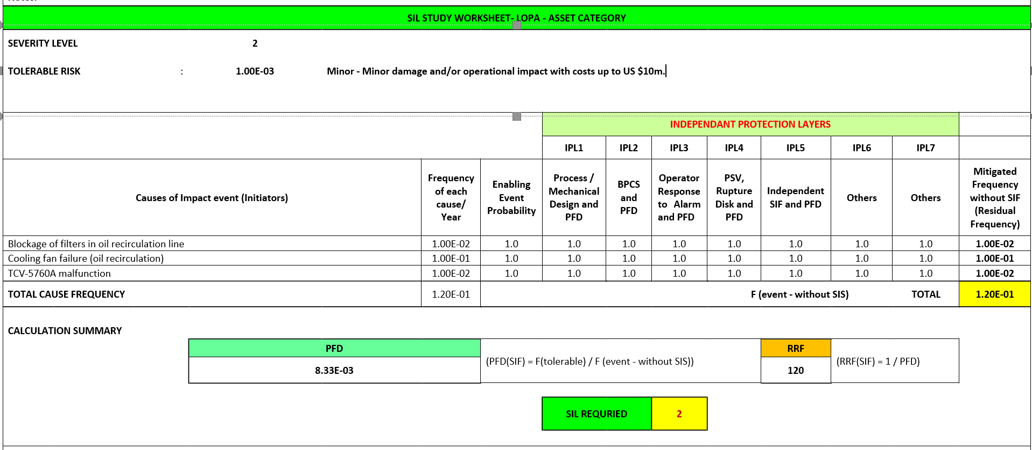
SIL Assessment - Layer of Protection Analysis (LOPA)

Slide 14
SIF Name | SIF Tag | SIF Description |  | Required |  |  | Achieved
 |  |  |  | SIL | RRF | PFH | SIL | RRF | PFH
SUCTION PRESSURE TRANSMITTER | 001, 029,030,031,032,033,037 FE21PT840104 | PTS Compressor Suction Pressure Low Low Trip |  | 1 | 10 | - | 1 ^{a)} | 93 | -
SUCTION PRESSURE TRANSMITTER | 002 FE21PT840104 | PTS Compressor Suction Pressure High High Trip |  | 1 | 10 | - | 1 ^{a)} | 93 | -
DISCHARGE PRESSURE TRANSMITTER | 003 FE21PT840106 | PTS Compressor Discharge Pressure High High Trip |  | 1 | 10 | - | 1 ^{a)} | 93 | -
DISCH. TEMP. TRANSMITTER | 004 FE21TT840106 FE21TT840106B | PTS Compressor Disch. Temp. High High |  | 1 | 10 | - | 2 ^{a)} | 135 | -
OIL PRESSURE TRANSMITTER | 005 FE21PDT840501 | PTS Compressor OIl Pressure Low Low Trip |  | 1 | 10 | - | 1 ^{a)} | 93 | -
OIL TEMP. TRANSMITTER | 006, 028 FE21TT840501 | PTS Compressor Oil Temp. High High |  | 1 | 10 | - | 1 ^{a)} | 93 | -
DIFF. PRESSURE TRANSMITTER | 007 FE21PDT840204 | PTS Compressor Seal Diff. Pressure Low Low Trip |  | 2 | 100 | - | 1 ^{a)} | 93 | -
Temp. Motor Winding | 008, 009, 010, #FE21TE840306_HH, #FE21TE840307_HH, #FE21TE840308_HH | PTS Compressor Motor Winding Temp. High High |  | 2 | 100 | - | 2 ^{a)} | 143 | -
Temp. Motor Bearing | 011, 012, 013 #FE21TE840309_HH, FE21TE840303A, FE21TE840303B | PTS Compressor Motor Bearing Temp. High High |  | 2 | 100 | - | 2 ^{a)} | 143 | -
BFW STEAM SYSTEM | 0117,0118,0119,0120,0121,0122,0123,0124,0124,0126,0127,0128,0129,0130,0131,0132,0133,0134,0135,0136 | BFW STEAM SSYTEM |  | 2 | 100 | - | 2 ^{a)} | 111 | -
Reformer and Core Area | 0137,0138,0139,0140,0141,0142,0137,0138,0139,0140,0141,0142,0143,0144,0145 | Reformer Protections and Core Area |  | 2 | 100 | - | 2 ^{a)} | 154 | -
Vibration Gear Box (3s) | 014, 019, 020 FE21VT840303, FE21VT840301, FE21VT840302 | PTS Compressor Gear Box Vibration High HIgh |  | 1 | 10 | - | 2 ^{a)} | 125 | -
Reactor Outlet gas (15s) | 0143, 0145 | Reactor outlet gas High High Temperature Trip |  | 2 | 100 | - | 1 ^{a)} | 45 | -
PG KO Drum 416-F | 0146 | PG KO Drum High High Level to trip Reduction |  | 3 | 1000 | - | 1 ^{a)} | 26 | -
COMPRESSOR BEARING TEMP. | 015, 016, 017, 018 FE21TT840301B, FE21TT840301A, FE21TT840302B, FE21TT840302A | PTS Compressor Bearing Temp. High High Trip |  | 1 | 10 | - | 1 ^{a)} | 44 | -
Axial Displacement | 021, 022, 023, 024 FE21ZT840301B, FE21ZT840301B, FE21ZT840301A, FE21ZT840301A | PTS Compressor Axial Displacement |  | 1 | 10 | - | 1 ^{a)} | 93 | -
External Trip Signal | 025, 027, 036, 038, 048, 071, 072, 073, 074, 075, 076, 077, 078, 079, 080, 081, 083, 089, 090,0105,0106,0107,0108,0109,0110,0111,0112,0113,0114,0115,0116 #PTGC_Trip | PTS Compressor External Trip |  | 1 | 10 | - | 1 ^{a)} | 93 | -
Remote Trip | 026,061,062,063,064,065,066,067,068,069,070,100,102,102,103,104 FE21TT140105 | Compressor |  | 1 | 10 | - | 1 ^{a)} | 93 | -
SUCTION PRESSURE TRANSMITTER | 034, 035 FE21PDI840222, FE21PDI840223 | PTS Compressor Buffer Gas Suction Pressure Low Low Trip |  | 2 | 100 | - | 1 ^{a)} | 81 | -
Fire Box Pressure Low (5s) | 041, 042, 043,044,045,046,047,048,049,050,051,052,053,054 FE51PT110202A FE51PT110202B FE51PT110202C | PG Heater Fire Box Pressure Low Low Trip |  | 2 | 100 | - | 1 ^{a)} | 86 | -
SEAL GAS SYSTEM N2 FLOW 1º STAGE | 055,056,057,058,059,060, FE21FIT140401 FE21FIT140401A | PG Compressor Seal Gas System N2 Flow 1st Stg. |  | 2 | 100 | - | 2 ^{a)} | 154 | -
STEAM TEMP. TURBINE STAGE 1 | 082,083,084,085,086,087,088,091,092,093,094,095, FE21TT140211 FE21TT140211A | PG Compressor |  | 1 | 10 | - | 2 ^{a)} | 139 | -
ABSORPTION TOWER LEVEL | 096,097,098,099 FE41LT110201A FE41LT110201B | CO2 |  | 2 | 100 | - | 2 ^{a)} | 162 | -
SIL Verification Results

Slide 15
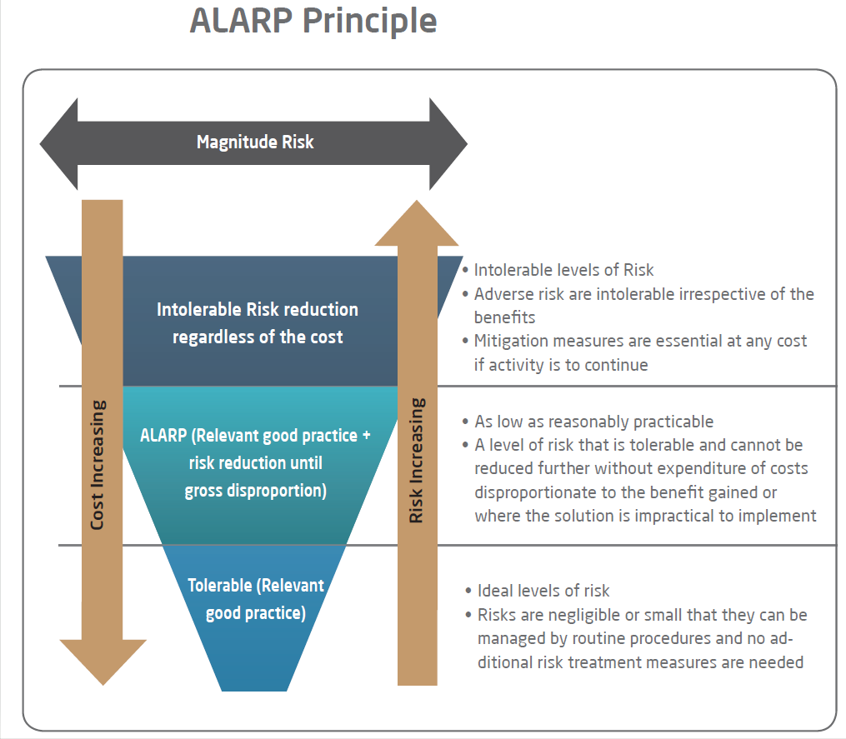
Preventing Injuries and Protecting People

Slide 16
Risk Reduction Strategies – Inherently Safer Design Strategy
Inherent risk management involves the elimination of a hazard or the reduction of the magnitude of a hazard to the point that its consequences on potential subjects of interest are tolerable (inherent = built-in).
Example: Water based paints instead of solvent based paints.
Other examples: A crude oil separator vessel is expected to be pressurized up to 600 psig, due to either an external fire or due to a blocked discharge. The mechanical design of the separator vessel has ensured that the vessel can withstand 600 psig.
Present-day design approach is to exhaust the inherently safer design alternatives, before employing external (passive / active) risk reduction.
Inherently Safer design is often expensive and is limited by the type of operation.

Slide 17
Risk Reduction Strategies – Passive Risk Reduction
Examples:
Vessel walls
Fire walls
Blast walls
Bunkers
Flame arrestors
Open vents
Dikes
Passive Risk Reduction Measures do not require movement of any parts.
They are considered extremely reliable, often reducing Consequence of an Event by a factor of 100 or more.
Process knowledge is key to Specify, Design, Manufacture and Construct passive risk reduction measures.
Considerations like Emergency Escape routes limit extensive use of passive risk reduction measures.

Slide 18
Risk Reduction Strategies – Active Risk Reduction
Active risk management involves alarms, interlocks, and mitigation systems designed to detect an unsafe condition and put the system into a safe state, usually either by taking emergency action to return the system to normal operating conditions or by shutting it down. Active systems may be designed to prevent an accident or to minimize the consequences of an accident.
Example: Very High level in a storage tank is sensed and the tank is isolated automatically, through automatic isolation valves.
Other examples: deluge systems, safety instrumented systems, interlock systems, emergency shutdown systems, relief valves.
Active risk reduction usually requires electrical or hydraulic power operation.
Since many operating parts will be involved, the system may not operate when there is a “demand” to operate.
The “Failure on Demand” must be minimized through formal analysis, in order to achieve a reliable active risk reduction.
A risk reduction of 10 to 1000 can be achieved by different designs.

Slide 19
Risk Reduction Strategies – Procedural Risk Reduction
Procedural Risk Reduction is the application of procedures in Risk Management.
Examples:
Work Permits
Training – Are all Operators trained on the plant operation?
Standard Operating Procedure – Are the SOPs up to date?
Safety Regulations – Are you aware of all the Safety Regulations?
Emergency Response Procedure – Do you have a Drill of ER
Maintenance Philosophy – What is your plant Maintenance Philosophy?
(Preventive, Breakdown, Time-based, Risk-based)
Tanks, Vessels, Pipelines Corrosion Monitoring
Safety: Is the Tank overfill protection system tested periodically?

Slide 20
Risk Reduction Strategies – Layers of Protection Analysis
Good process design RRF: 10 (Once in 10 yrs.)
Operator action RRF: 10
DCS RRF: 10
Emergency Shutdown (ESD) RRF: 10 to 1000
Pressure Safety Valve (PSV) RRF: 100
Dyke / Tank overflow line RRF: 100
RRF: Risk Reduction Factor. It is the Factor of (usually Likelihood or frequency) reduction of an Event.
Exercise: An Organization has a Target of 1 serious injury or significant equipment damage in 10000 years due to vessel overpressure leading to rupture and explosion, of a separator vessel. A LOPA analysis showed that the Event can be initiated with a Likelihood of once in every ten years. The vessel has a DCS pressure control loop (RRF 10) and an ESD loop to shutdown the plant. Calculate the RRF of the ESD loop to achieve the Organizational Risk target.
Solution: (1/10)x(1x10)x10000 = 100. ESD loop shall have RRF of 100.
Whether we use a quantitative target RRF for an ESD loop or not, all ESD loops greatly contribute to the Risk reduction, usually by a factor of more than 10 up to 1000.

Slide 21
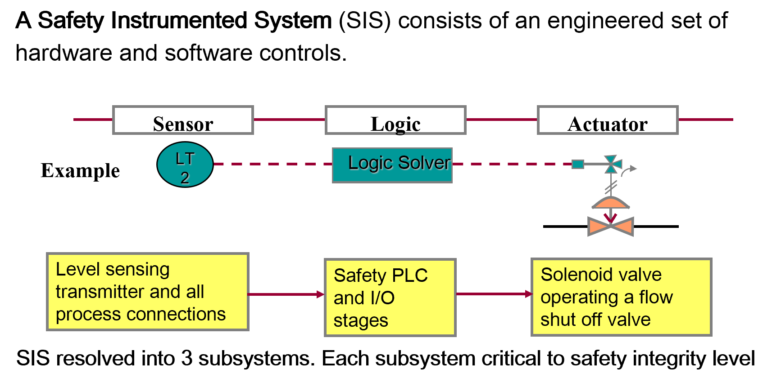
Functional Safety – Parts of a SIF Loop

Slide 22
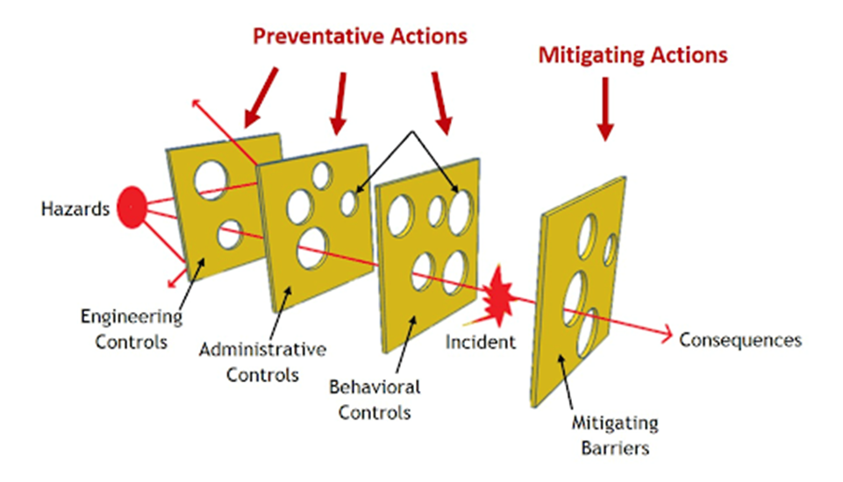
Risk Reduction – Swiss Cheese Model
In the Swiss Cheese model, the available Safety Layers are modelled as a series of barriers, preventing the hazard to reach the consequence.
Since each Layer of Protection has an estimated failure rate and type (mode) of failures, the consequence is usually a combinational failure of multiple protection layers.
Engineering Controls reduce likelihood of events. Hence the most beneficial method of Risk reduction is to ensure
ALL ENGINEERING CONTROLS MUST WORK WHEN DEMANDED
Figure from: umich.edu
Engineering Controls: Process Design, DCS, ESD.
Administrative Controls: Restricted entry & Permit to Work System
Behavioral Controls: Reduction of unsafe behaviors of O&M personnel, Contractors.
Mitigating Barriers: Fire Fighting, Emergency Response.

Slide 23
Risk Reduction Strategies – Better Alarm Management
EEMUA 191, IEC 62682 & other Standards requires that all Alarms are presented to the Operator with a clear actionable format. The number of Alarms presented at one time (standing alarms or alarms within 10 min. after an upset should not exceed ten (10). This is a hugely difficult target but must be met.
Discussion point:
What action do you take if you receive a Tank High Level Alarm?
How many alarms do you receive in 24 Hrs.?
Do the Alarm messages always convey clear message?
Do you have SOPs recommending action to be taken upon receiving every alarm?

Slide 24
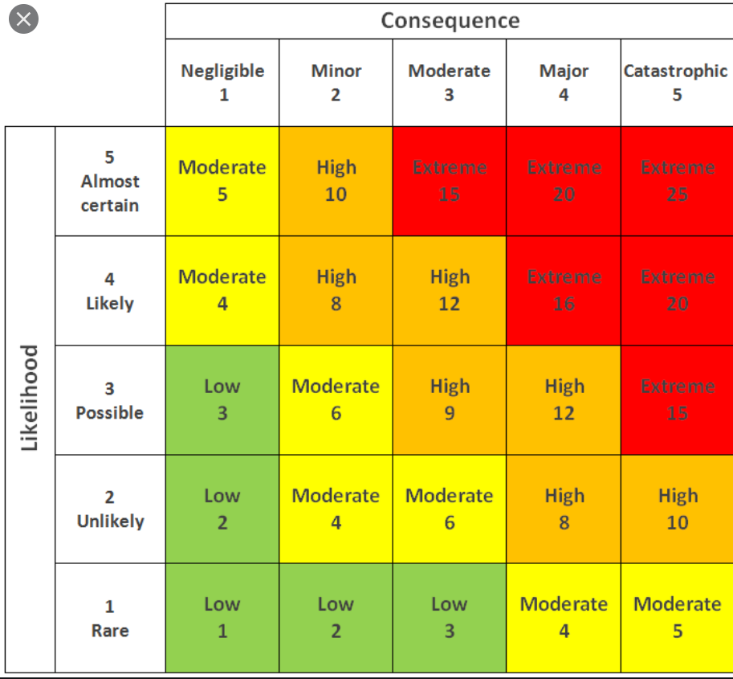
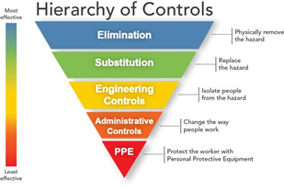
Risk Reduction
Risk = Consequence x Likelihood
Almost certain event leading to “moderate” consequence; Risk = 5 x 3 = 15
Possible event with Catastrophic consequence; Risk = 3 x 5 = 15
Question: Which risk would you attempt to reduce first?
Answer: All the “unacceptable” risks shown in RED color.
Depending on the nature of Plant, certain risks are unavoidable.
The first attempt to reduce the risks is usually to reduce the frequency
Sometimes, it may be possible to reduce the consequence. Elimination & Substitution are more effective than Engineering (Safety) Controls.
Risk Reduction is mandatory by Law

Slide 25
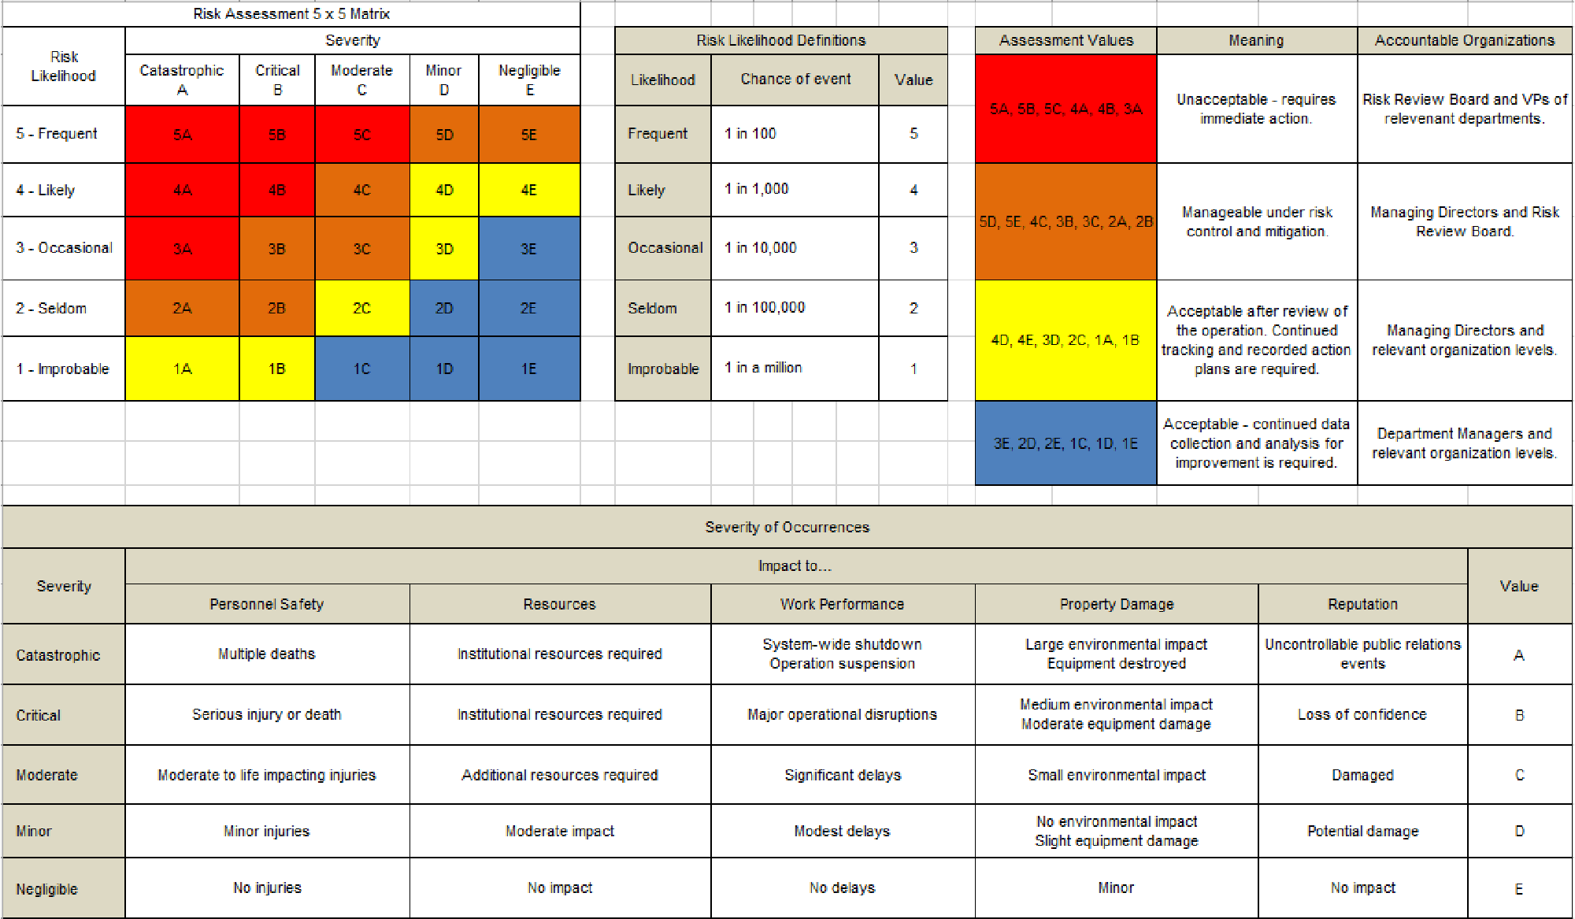
Principles of Risk Management – Risk Matrix
In order to ensure that Process Hazards are minimized, we must use the concept of Risk Tolerance for Risks arising out of Process Hazards.
All leading Companies have Risk Tolerability Criteria both for Workplace Risk and Process Risk.

Slide 26
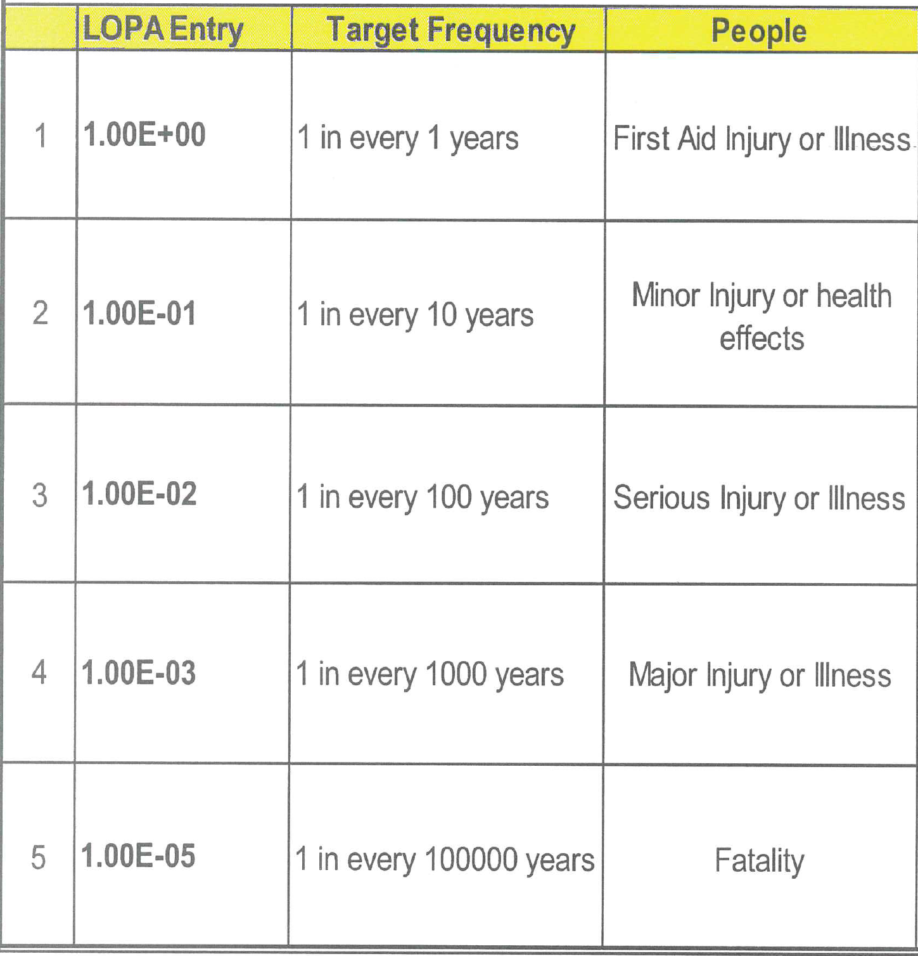
Risk reduction using Instrumented Protection Functions (IPF)
HAZOP study determined that failure of a chemical valve is likely to result in an explosion that might kill 10 people. If this component will fail once in every 10,000 years.
i. What is the risk associated with this component?
Ans: The failure rate of the valve is 0.0001 failures per year. Therefore, the risk of a fatality is 10x0.0001 = 0.001 deaths per year.
ii. Is the Risk acceptable to your company? (Is the Risk equivale to or less than the TMEL).
Ans: The TMEL for our company is 1.00E-05 (0.00001) per year. Hence the Risk of 1E-03 (0.001) is not acceptable. This risk is 100 times more than what is acceptable.
iii. It was determined that all passive and other types of risk reductions are already in place. Hence recommend an Instrumented Protection Function (IPF) and assign a quantitative risk reduction to it.
Ans: Install an automatic shutdown valve upstream of the chemical valve. It must achieve a risk reduction of 0.001/0.00001= 100. RRF = 100.
Example TMEL for personal safety
TMEL: Target Mitigated Event Likelihood

Slide 27
Functional Safety - Safety Integrity Level (SIL) – Probability of Failure on Demand (PFD)
Functional safety is the part of the overall safety of a system or piece of equipment that depends on automatic protection operating correctly in response to its inputs. Functional Safety is an approach to achieve a specified magnitude of risk reduction.
Safety integrity level (SILs) defines the maximum number of times that a system built to a particular integrity level would be expected to fail in a given period of time. SIL should be considered as a performance level of Functional Safety.
PFD=1/RRF
Low Demand Mode (> 1 year)
Demand Mode: (functions < 1 year)
Note: The emergency shutdown function that we introduced with RRF of 100 should be assigned “SIL 2”.

Slide 28
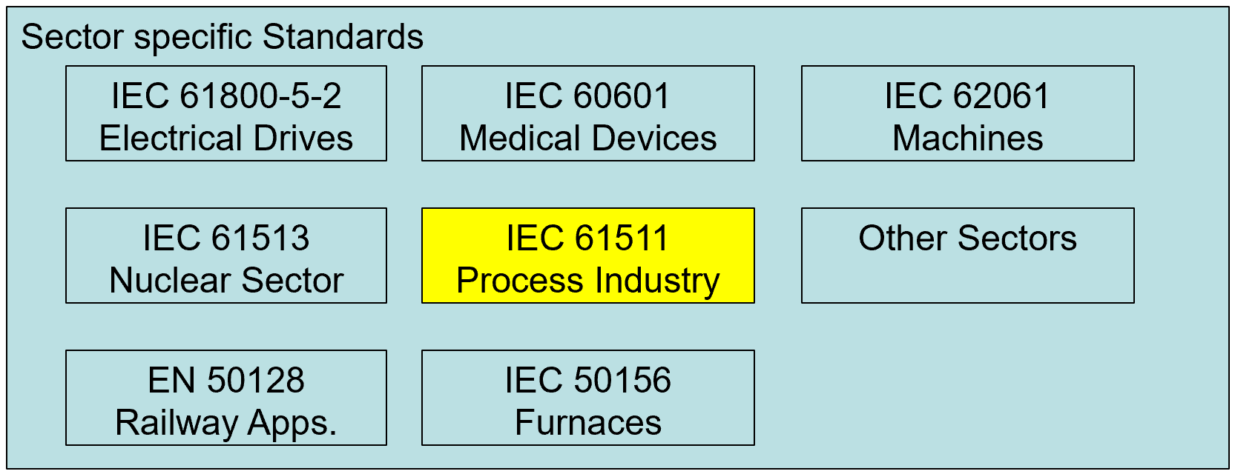
Functional Safety – Safety Integrity System
IEC 61508 is an umbrella standard for Functional Safety. Latest version is 2nd Edn. 2010.

Slide 29
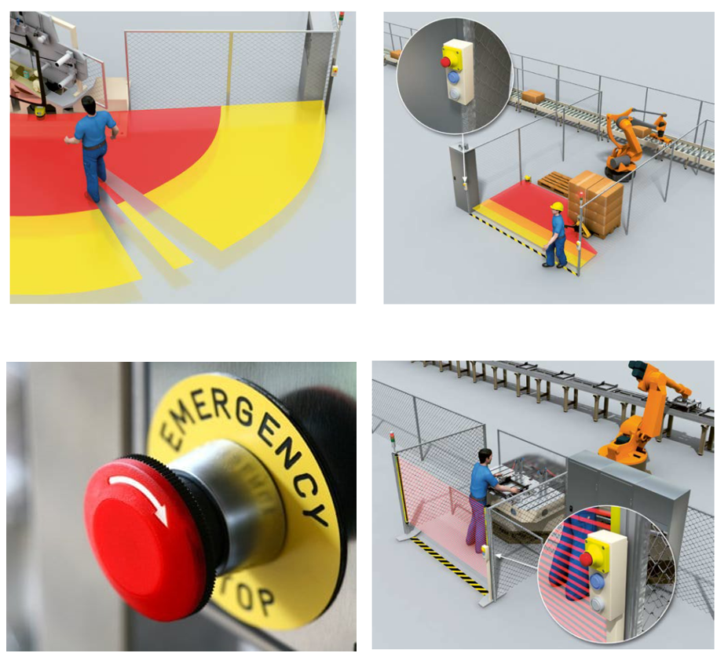
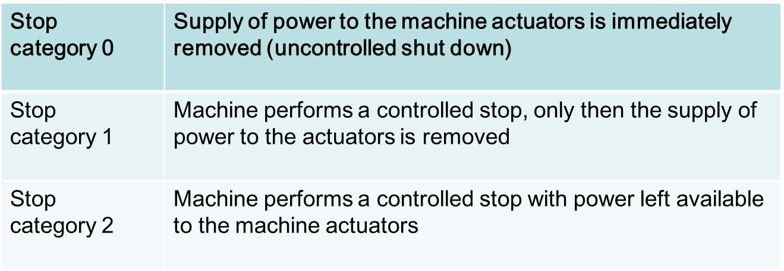
Functional Safety Management – Machinery – IEC 62061
Common safety related control functions:
Stop function
Emergency stop
Manual/auto reset
Start and restart
Wait time

Slide 30
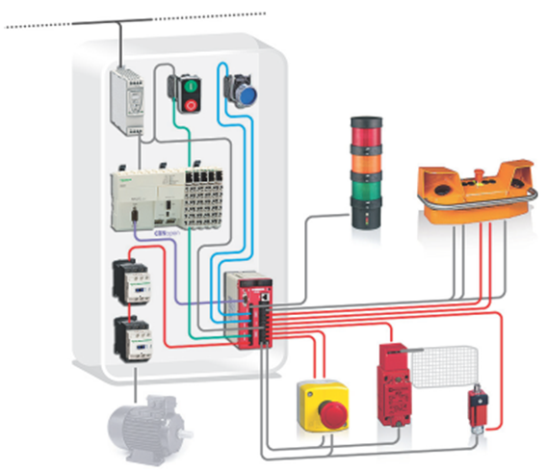
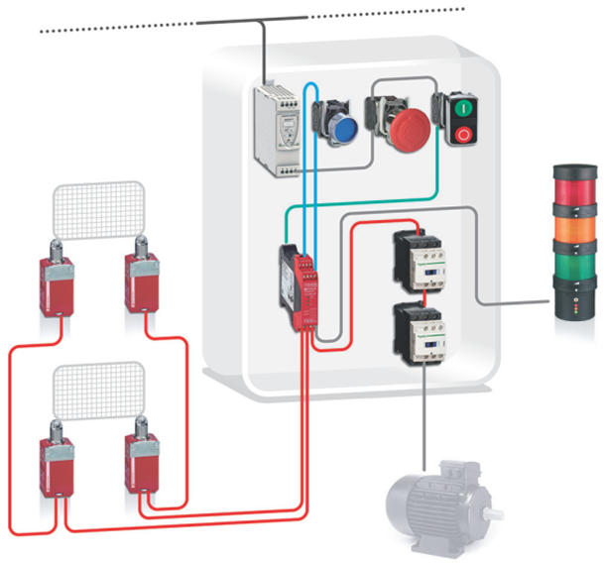
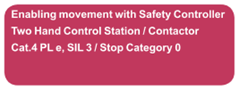
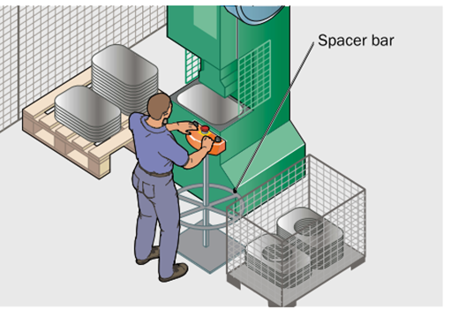
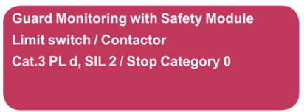
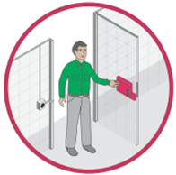
Functional Safety Management – Machinery – IEC 62061
Two-Hand Control
Guard Monitoring
Source for this page: Schneider Electric

Slide 31
Preventing Injuries and Protecting People

Slide 32
Thank You
&
Thanks to ASSP Nigeria!

Slide 33
Q&A

