Slide 1
MENTAL HEALTH DISCLOSURE IN THE WORKPLACE
CHALLENGES AND SUPPORTIVE STRATEGIES
Delivered by Ifeoma Okpara FISPN

Slide 2
WHICH PATH FOR MENTAL HEALTH???

Slide 3
What Mental Health is ...
Mental health is a state of mental well being that enables people to cope with the stress of life, realise their abilities, learn well and work well and contribute to their community.(WHO)

Slide 4
Facts about mental health
About 3.9% of Nigerians had depression disorders while 2.7 (4.9 million) had anxiety disorders.
WHO estimates that a whooping 20% of Nigerians or about 40 million people are affected by mental illness.
Studies also show that more prevalent mental health issues in Nigeria include depression and anxiety.

Slide 5
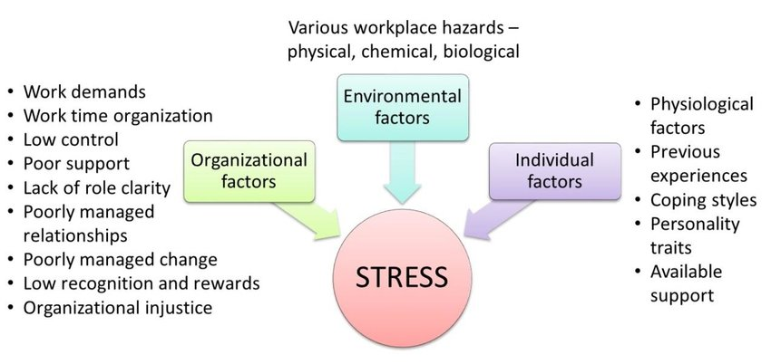
Factors affecting Mental Health

Slide 6
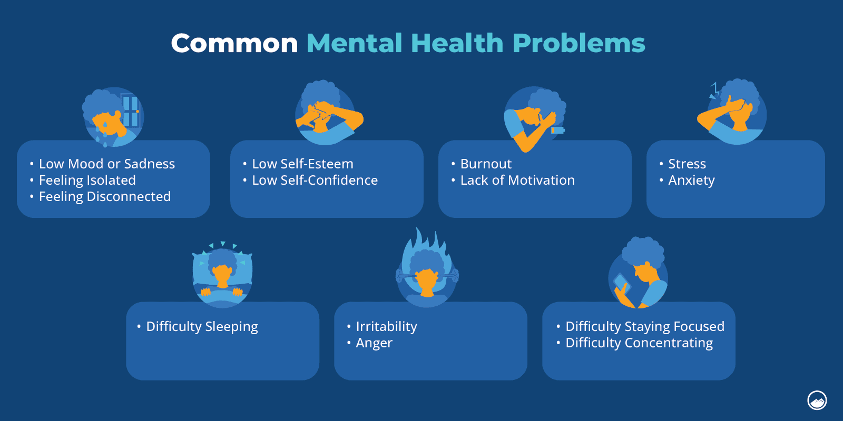
Signs of common mental health problems

Slide 7
MENTAL HEALTH DISCLOSURE: ITS ATTENDING CHALLENGES
Unveiling the Struggles: Navigating the Challenges of Mental Health Disclosure

Slide 8
Mental Health disclosure in the workplace is a complicated issue presenting both challenges and opportunities for improvement. Workplace culture on the other hand plays a significant role in shaping employees’ willingness to disclose mental health issues directly impacting their wellbeing and productivity. As awareness around the importance of mental wellbeing increases, so does the need for employers to understand and address the impacts that mental health issues have on work outcomes.

Slide 9
MENTAL HEALTH DISCLOSURE: ITS ATTENDING CHALLENGES
•Mental health disclosure refers to the process by which an employee informs their employer or colleagues about a mental health condition. While disclosure can foster support and access to accommodations, it also presents several challenges.
•Disclosure of mental health problem in the workplace can lead to discriminatory behaviours from managers such as micro managing , lack of opportunities for advancement, over inferring mistakes to illness, gossip and social exclusion.

Slide 10
STIGMA
One of the primary obstacles to mental health disclosure is the persistent stigma surrounding mental health conditions. Employees may fear that disclosing a mental health issue will lead to being labelled as weak or incapable, which could harm their professional reputation. This concern is not unfounded, as mental health conditions are still misunderstood in many workplaces.
Stigma involves a process of labelling, stereotyping and separating people into more or less favourable groups and categorizing entities of ‘them and us’, which can lead to a loss of status and discrimination. People who experience mental health problems are impacted by stigma often navigate complex decision-making processes when considering if, to whom, when, where and even why to disclose their mental health issues.

Slide 11
Job Security Concerns
Many employees worry that disclosing a mental health condition may jeopardize their job security. They may fear termination, demotion, or reduced opportunities for advancement due to perceived limitations. This concern is particularly prevalent in competitive industries, where high performance and resilience are often prized, and any sign of vulnerability is viewed as a potential liability

Slide 12
CONFIDENTIALITY/PRIVACY CONCERNS
Disclosure of a mental health condition inherently involves sharing personal information, and employees may be concerned about how this information will be handled. The fear that sensitive information could be shared beyond the intended audience or used against them can discourage disclosure. Employees often question who will have access to their disclosed information and whether their confidentiality will be respected

Slide 13
LACK OF SUPPORT AND UNDERSTANDING
Even in workplaces that aim to be inclusive, a lack of understanding about mental health can be a significant barrier to disclosure.. Managers and colleagues who are unfamiliar with mental health issues might react inappropriately, either by overreacting or minimizing the issue. This lack of awareness can deter employees from being open about their mental health struggles.

Slide 14
SUPPORTIVE STRATEGIES
The way forward

Slide 15
Government/Authorities
Cultural Influence
Primary Health Care
Task-Sharing
Human Resources
Laws & Resources
Government Actions

Slide 16
Employers
Promoting flexible schedules
Providing support and resources such as Employee Assistance Programme
Wellbeing leave
Promoting Healthy Work-Life Balance
Fostering a culture of open communication

Slide 17
Employees: Disclosure benefits
1
Access to Accommodations: Disclosure can lead to helpful accommodations, such as flexible schedules or workspace changes to manage stress.
2
Improved Mental Health: Open discussions about mental health can reduce the stress of hiding symptoms and lead to better management.
3
Increased Trust: Supportive responses to disclosure can build trust and improve team dynamics.

Slide 18
UNSUPPORTED WORKER
01
02
03
04
05
Employee becomes unwell, feels burnout
Employee not safe to discuss/ignore
Ad hoc time off, performance drops
Doctor signs off, pills, disengagement
Long term sick? Leaves? Expensive mess.

Slide 19
SUPPORTED WORKER
01
02
03
Employee becomes unwell
Safe to speak: someone listens, manager engages
Adjustments, counsellor, support
04
05
Performance improves in time
Employee stays, team is ally, recovery quicker

Slide 20
Where do we find stress in hierarchies?
TOP? MIDDLE? BOTTOM?

Slide 21
TAKE HOME MESSAGE
The most prevalent reason people have for not disclosing their mental health problems is that workers are afraid it would affect their career.
Supervisors/managers and co-workers are two groups that critically contribute to mental health in the workplace.
Significant proportion of workers have mental health disorders who are either struggling at work or are trying to return to work from a disability leave.
Support of these workers could benefit their workplace and minimize productivity loss.
Organisations need to take more proactive approach to building and maintaining a positive and supportive workplace culture.
By making disclosure safe, stigma and burden of mental disorders in the workplace can be decreased

Slide 22
LETS HEAL OUR WORKPLACES
AND
MAKE THEM A HEALTHIER SPACE!

