Slide 2
ISO 31000: 2018 Adapting Risk Management guidelines for OSH Professionals
6th ASSP Nigeria Chapter PDC
Sustainable Safety for National Development
Jason Kamalu CSP, MASSP

Slide 3
Learning Points
At the end of this presentation. we will share ideas on:
Nigerian Country Profile on OSH 2016
Participatory & System approach
Risk Management – Core element Technical Capacity
Paragigm Shift - Risk Based Thinking
Risk Management guidelines, Principles and framework
Elements of the Risk Management Process
Risk Management tools for safety professionals

Slide 4
Sustainable safety and National Development
Lessons Learned on Nigeria Country Profile on OSH 2016
C187

Slide 5
1. “OSH does not only seek to secure the safety and health of persons at work but consequentially stimulates productivity in the business of the enterprise. “
2. The current leadership of this nation is very much interested in the protection of the labour force and the revitalization of the economy for improved wellbeing of the generality of the people.
3. “A systems approach to occupational Safety and health has been widely proven to be an effective strategy for sustainable safety and health and management ...
4. ..to secure the much desired preventative occupational safety and health culture through the participatory implementation of OSH Programmes by stakeholder”
SENATOR (Dr) Chris N. Ngige (OON, MD, KSJI )
Honourable Minister of Labour and Employment
Excerpt from the Foreword of the OSH Profile
Source: www.ilo.org

Slide 6
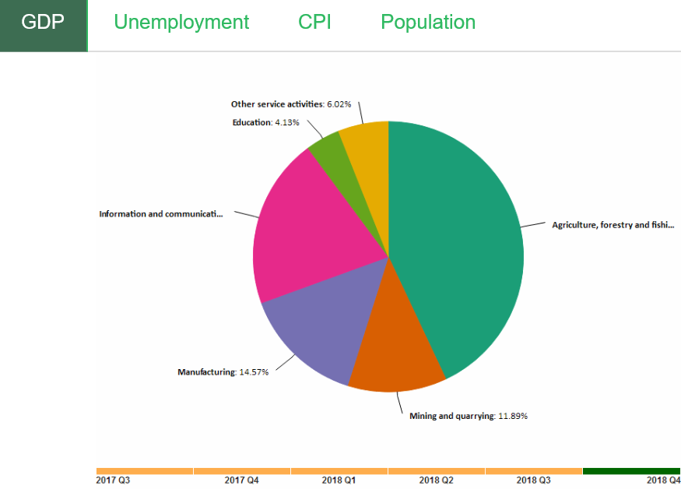
National Development
Improved wellbeing of the generality of the people
Protection of the labour force
Revitalization of the economy
National Bureau of statistics
OSH
Safety& health of Persons at work
Productivity in the business of the enterprise
True National development transcends political, infrastructural and economic growth but should affect social well-being of its people.
People Should feel safe and secure

Slide 7
3 Keys to sustainable Management of health and safety
System Approach to Occupational Safety &Health
Participatory Implementation of OSH Programmes stakeholders
Leadership Commitment & Political Will

Slide 8
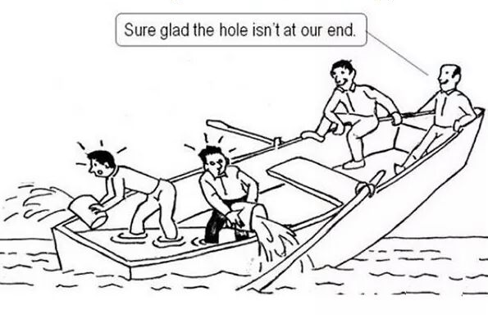
Participatory Approach
Sustainable safety
requires proactive stakeholders Participatory, Collaborative, Consultative approach at all functions & level not a territorial approach
Government
Labour
Employee
National OHS
Council
Management
H&S Committee
Union
Enterprise
JHSC
Tripartite Approach

Slide 9
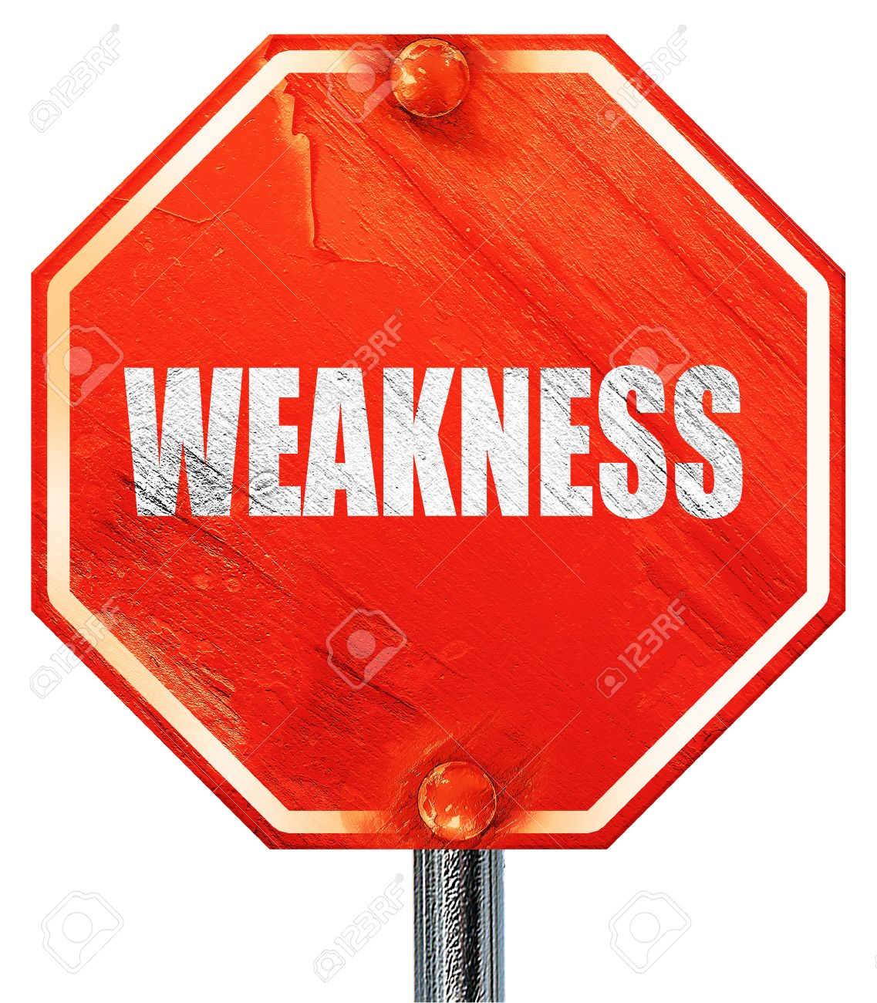
WEAKNESS
Shortage of appropriately trained and certified OSH personnel
Lack of coordination among stakeholders regarding OSH Practices and programmes.
Lack of holistic and contemporary National OSH Act
Limited coverage of workplaces by extant OSH laws
Inadequate logistical capacity to carry out enforcement activities
Lack of research in OSH
Inadequate OSH information Management Data collection, collation and dissemination
Overlapping functions of some institutions which are not necessarily backed by statues
No nationally approved OSH Code of practice
Underreporting of occupational accidents and diseases

Slide 10
Low awareness levels about OSH Legislation and role of OSH institutions among stakeholders
A large and growing informal sector
A large young and inexperienced workforce
New investors with poor or no commitment to OSH
Large number of workers not registered with employers organization
Under reporting of accidents by employers
Inadequate funding of OSH institution
Inadequate OSH technical Capacity among stakeholders
Inadequate capacity funding (human resource and geographical coverage) among existing OSH advocacy group Weak Regulation of sustainable safety
High Level of Poverty

Slide 11
Fatalities/Injuries Record 01/2014 – 09/2016]
Note: Under reporting of accidents and fatalities should factored
Source: Nigeria Country OSH Profile

Slide 12
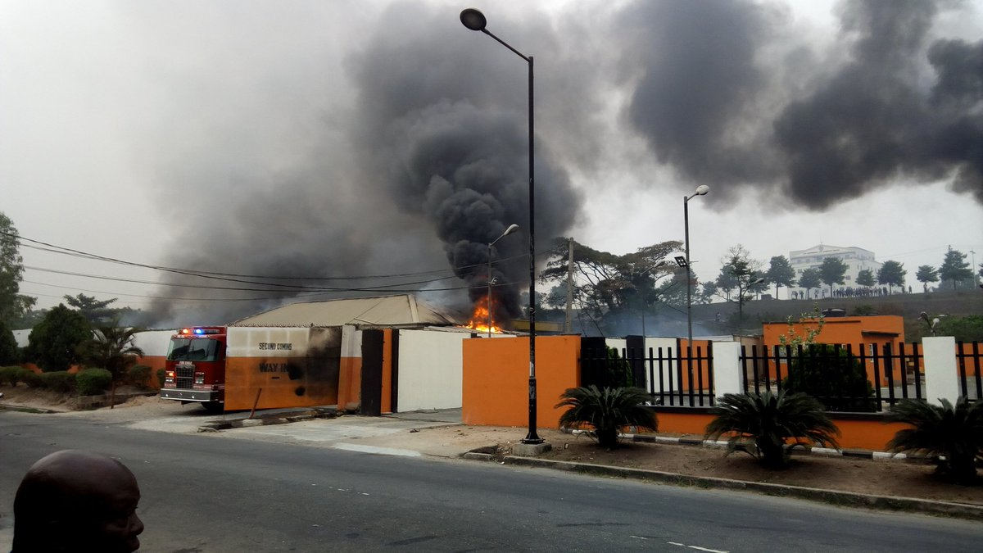
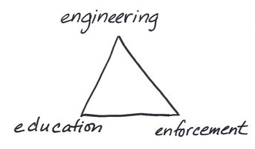
Major Incidents from 2018
Jan 2018
Gas explosion occurred at Second Coming Gas Plant located on CMD Road in Magodo area of Lagos state (7 dead)
June 2018
Fuel Laden Tanker explodes in Lagos
(12 dead)

Slide 13
Tying the issues to Risk Management
INSHPO Professional capability framework
System Approach – Proactive Risk based practices

Slide 14
RM/RA fundamental to
OHS PROFESSIONAL CAPABILITY FRAMEWORK
Activity Matrix
3. OHS Risk Management processes.
Knowledge
Matrix
HAZARD AND RISKS
Skill Matrix
Problem solving and critical thinking
HAZARD AND RISK CONTROLS
Practitioner
Position Profiles
Professional
Deciding strategies
www.Inshpo.org
Level
Awareness
Routine Application
Comprehensive Application
Creative Mastery

Slide 15
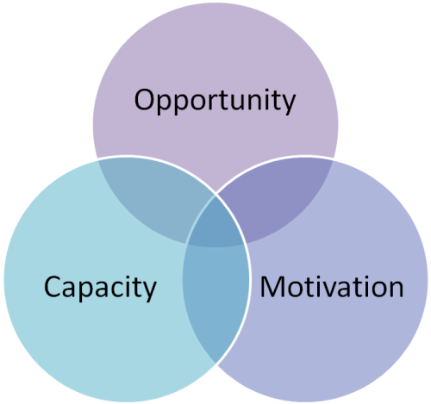
OHS Professionals
Design
Build/purchase
Install Phase
Operational Phase
Decommission Phase
The capable OHS professionals has generic knowledge appropriate to risk in all activities and employment supported by deeper knowledge of his or her specific industry including its characteristics hazards and risk prevention, management and mitigation processes . They also possess a broad understanding of a core range of hazards and hazards controls
Legal Requirement
Company Objective
3rd party HSEMS Audit
2nd party Audit
Ability & Risk Management Competence
RM tools
Prof Fred Herzberg Model: Motivation/Hygiene Theory

Slide 16
Risk Management & Organizational Culture
Generative
Gives priority to work
Proactive
Cares about Safety and makes plans in advance to achieve it
Calculative
Cares about safety in a rule-bound way only when it can be shown to be cost neutral and advantageous.
Reactive
Pathological
Cares about Safety only after something goes wrong.
Does not Care about Safety
Organizational Classification based on maturity in approach to managing OHS Risk
Organization should define the strategy and establish the context

Slide 17
Mentorship and Risk Management Competency void
Akeem Mustapha CSP
Source: HSEPros
Feedback on Mentorship

Slide 18
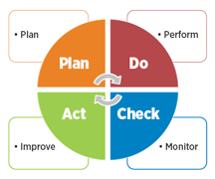
Systems Approach
Risk Based thinking and approach
2018

Slide 19
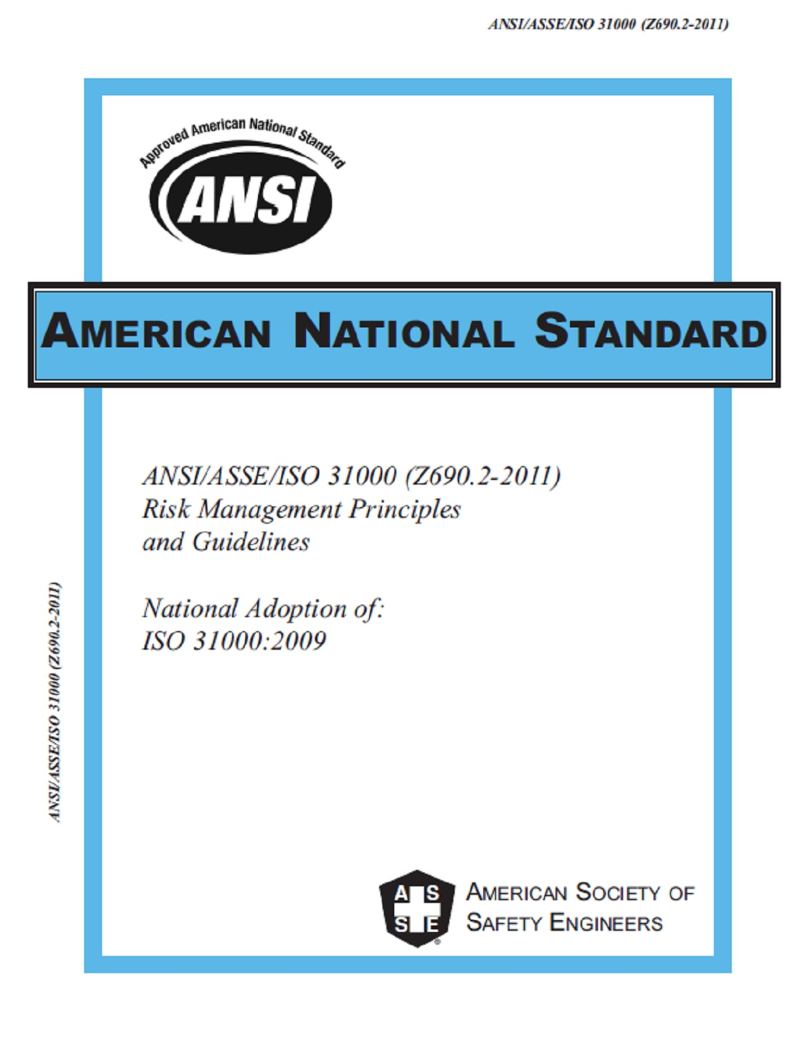
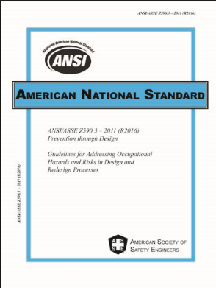
The ISO 31000 Risk Management standard provides organizations the principles, framework and process for managing risk.
ANSI/ASSE Z590.3
Prevention Through Design
ISO 31010
ANSI/ASSE Z690.3 -2011 (R2016)
Risk Assessment Techniques.
ISO 31000
ANSI/ASSE Z690.2
Risk Management Principles & Guidelines
ISO Guide 73:2009 (ANSI/ASSE Z690.1-2011), Vocabulary for Risk Management
ISO 31000 was written from a much broader perspective and designed to address all types of risks including those that have negative and/or positive consequences
Prevention through Design standard is written to address occupational safety and health risks over the entire life cycle of a system

Slide 20
Risk Management Guidelines - Principles, framework, process.
ISO 31000 Risk Management Standard

Slide 21
Practical Value for the OHS Professional
Improve understanding & Fluency in appropriate risk management terminology
Knowledge Gap & HSE Competency
Occupational Mobility
Dexterity in the use of RM tools
Different risk models

Slide 22
RISK BASED APPROACH
Proactive Risk Based Practices
Risk Based
Systems oriented
Risk Management Driven
Prevention thru Design
Hierarchy of controls
Program Oriented
Compliance driven
Hazard Based
Traditional
Most times reactive

Slide 23
Risk
The effect of uncertainty on objectives
Deviation from the expected
Positive, negative or both
Opportunities and threats
Expressed in terms of risk sources, potential events, their consequences and their likelihood.
Reduce Uncertainty
Improve Decision Making
Protect People and Assets
Achieve Business Objectives
Objectives of risk Management

Slide 24
UNDERSTANDING RISK CONCEPTS
Hazard Risk
Financial Risk
Markets
Credit
Price or liquid
Operational Risk
Business processes
Internal Systems
Strategic Risk
Economy
Society
Reputation
Operational
Hazard
Financial & Strategic
Pure Risk
Speculative Risk
Risk
Exposure
Trigger
Incident
Consequence
Risk Driver

Slide 25
WHY MANAGE OHS RISKS
Improperly managed OSH risks may lead to operations shut down due to incident investigations, resulting in financial losses, failure to fulfil orders, insurance premiums increase and reputational damage.
Risk
Exposure
Trigger
Incident

Slide 26
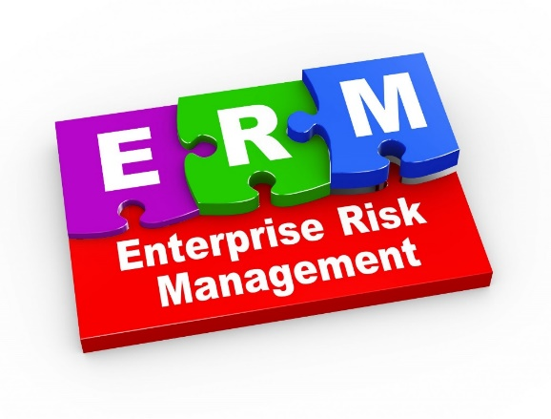
Enterprise Risk Management
Enterprise Risk Management – a strategic business discipline that supports the achievement of an organizations objectives by addressing the full spectrum of its risks and managing the combined impact of those risks as an interrelated risk portfolio (RIMS 2017)

Slide 27
ISO 31000:2018
Risk Management Principles & Guidelines Clauses
2
Norm Ref
1
Scope
3
Terms & Def
4
Principles
6
Process
5
Framework

Slide 28
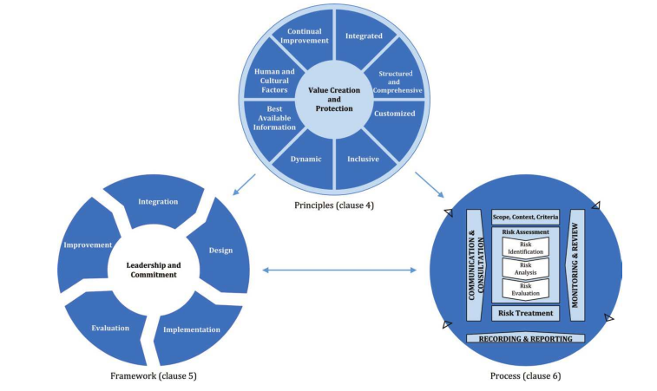
RELATIONSHIP
RM PRINCIPLES, FRAMEWORK, PROCESS
9 elements
The principles are the foundation on which the framework and process are built as described in the ISO 31000 standard.
6 Elements
7 Elements

Slide 29
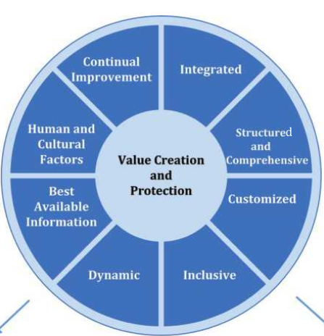
Principles
Value Creation & Protection
Integrated
Best Available Information
Human Cultural Factors
Continual Improvement
Structured and Comprehensive
Customized
Dynamic
Inclusive

Slide 30
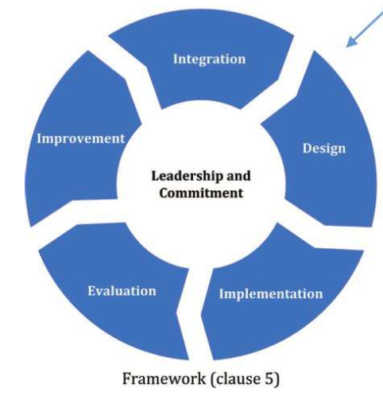
Framework
Leadership &
Commitment
Design
Implementation
Evaluation
Integration
Improvement
PDCA Model

Slide 31
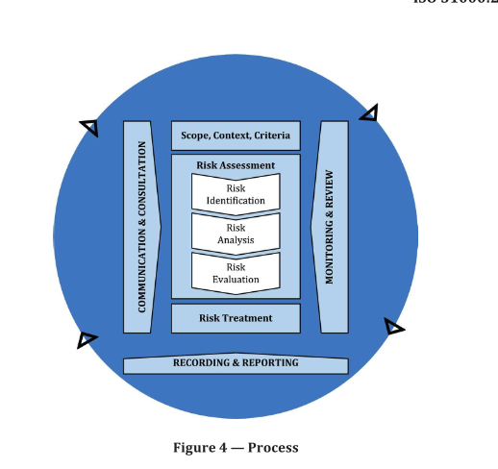
RISK Management Processes
PDCA Model
PDCA Model

Slide 32
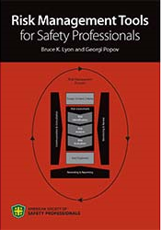
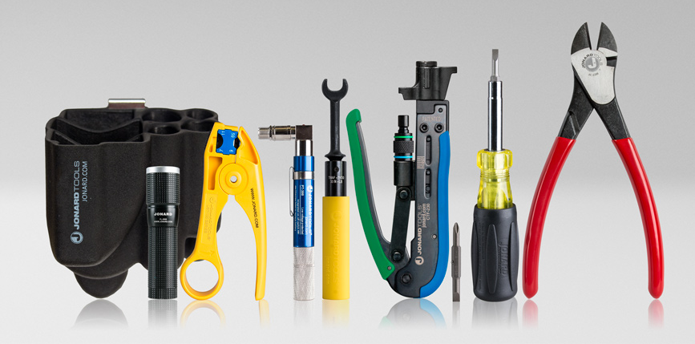
Risk Management Processes & Tools
Selecting, combining and adapting tools for Risk Management professionals

Slide 33
Risk based information must be communicated to decision makers effectively
(Before during after]
Consultation
Seeking views before making a decision
Risk Communication
Plan do Check Act Model
Risk Based Decision Making
Risk Assessment Triggers

Slide 34
Establishing Context
Risk Criteria
Risk Scoring system
Pareto Analysis
Risk Assessment Matrix
‘Establishing the context’ sets the purpose and scope for the risk management process and defines the criteria against which the risks will be assessed. It is especially important that the context be in alignment with, and in support of the organization’s goals and objectives.

Slide 35
Risk Identification Tools
Brain
storming
Checklists
Delphi Technique
Design Safety Review
Hazard Identification
(HAZID)
Nominal Group Technique

Slide 36
Determine Controls
Effectiveness reliability
Analyze nature & magnitude of consequences
Analyze likelihood
(Predictive analysis, historical data, expert opinion)
Measure risk
(QLA, QRA)
Risk Analysis
Bow Tie Analysis
Event tree
Fault Tree
Failure Mode and Effect Analysis(FMEA)
Hazard & Operability Study (HAZOP)
JHA/ Job Risk Assessment (JRA)
Layers of Protection Analysis
Preliminary Hazard Analysis
Stripped Bow Tie Risk assessment
Structured What if technique (SWIFT)

Slide 37
Determining acceptability of risk
Based on acceptable risk levels
Risk Evaluation
As low as reasonable Practicable (ALARP)
Risk Heat Map
Risk Indices

Slide 38
Risk Treatment
Hierarchy of controls
Business Impact Analysis
Cost/Benefit
Analysis
Multi criteria Analysis
The End result of risk assessment
Prevention
Prevent of occurrence
Protection
shield from harm
Mitigation
Reduce Severity
Control
Reduce likelihood and severity

Slide 39
The primary goals of monitoring and reporting in a risk management framework are to measure the implementation and performance of risk assessment, risk treatment and overall risk management; and establish effective metrics to achieve risk reduction objectives within the organization.
Monitoring & Reporting Tools
Risk Matrix
Risk
Register
Key
Performance
Indicators
Key
Risk Indicator
Risk
Perform-ance
Measure-ment

Slide 40
Risk Scoring Systems
Risk Factors - Risk factors are the variables used to measure risk and produce a risk score.
Risk factors and their risk assessment codes used in various three and four dimensional models include the following:
Exposure (E) - measure of exposure events/units.
Frequency of Exposure (F) - number of exposure events for a unit of time.
Time Duration of Exposure (T) - time period that a single exposure occurs.
Vulnerability (V) - weaknesses in a system that are factored into the risk estimation.
Detection of Failure (D) - estimate of how easily the potential failure could be detected prior to its occurrence.
Control Reliability (CR) - the reliability of a selected control into the risk estimation.
Prevention Effectiveness (PE) - a controls effectiveness in preventing a failure from occurring.

Slide 41
Risk Management tool selection considerations
Process Step
Communication and consultation
Establishing the context
Hazard/Risk Identification
Risk Analysis
Risk Evaluation
Risk Treatment
Monitoring and reporting
Application Level
Organizational
Regional
Plant/Location
Department
System/Process
Job
Task
Hazard/Exposure
General hazards
Energy Sources
Chemical
Machinery
Robotics
Industrial hygiene
Environmental
Musculo-skeletal
Error-induced
Other

Slide 42
Risk Management tool selection considerations
Criticality
Degree of uncertainty
Degree of FSI risk
Critically or Sensitivity of targeted operation
Output
Degree of detail needed
Availability of reliable data
Decision Making needs
Regulatory or legal requirements
Risk levels or scoring system needs
Resources
Budget
Timeframe
Personnel and skill levels
External consultants
Software tools

Slide 43
CONCLUSION
As organizations evolve with the use of different systems and methodologies to manage different risks.
OSH risk professionals will be expected to have sufficient skills in applying risk management principles. As well as selecting, modifying and adapting risk management techniques.

Slide 44
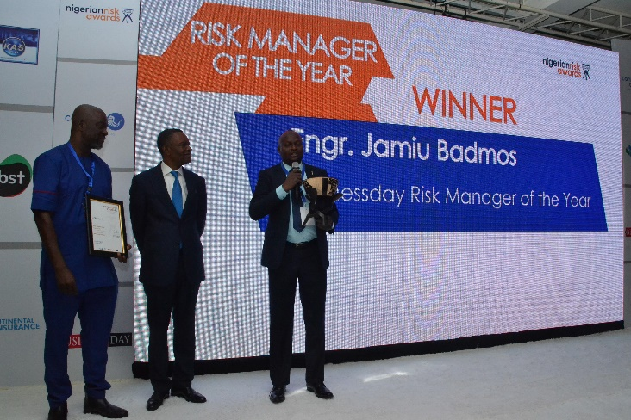
Risk Management Opportunities
Bespoke
Risk Management courses & Risk Assessment
Training.
Nigerian workers feel safe and secure in their work environment.
All risk would have been determined, assessed and controlled and well being.
3. Sustainable safety for National development
Mentorship

Slide 45
THANK
YOU

