Slide 2
Risk Based Thinking: Taking Ownership and Enhancing Sustainable Safety Culture
Engr. JAMIU BADMOS

Slide 3
Learning Points
The Big Picture
What is Risk Based Thinking
Looking through ISO 45001:2018
Risk Based Thinking Initiatives
Final Message

Slide 4
Respect to All Safety Leaders

Slide 5
The BIG PICTURE
Compliant Worker
Non Compliant Worker
Committed Worker

Slide 6
“I don’t want a culture of compliance, I want a culture of commitment.”

Slide 7
A culture that truly values ethical (and safe) behavior must be led by men and women committed to principle for its own sake, not solely for the purpose of compliance.

Slide 8
Risk Based Thinking is the Solution
A danger foreseen is half avoided - Proverb

Slide 9
What is Risk Based Thinking?

Slide 10
Is it a new Concept?

Slide 11
Turn to the person next to you, take 2 minutes and answer the two questions

Slide 12
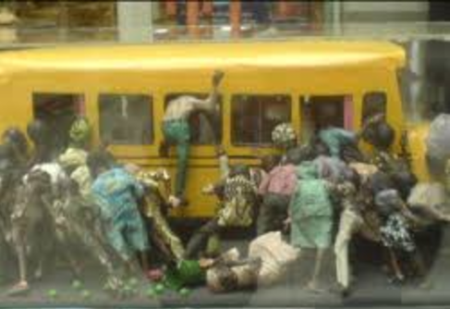
“The MOLUE Concept”

Slide 13
Risk Based Thinking
Risk Based Decision Making
Risk Based Problem Solving

Slide 14
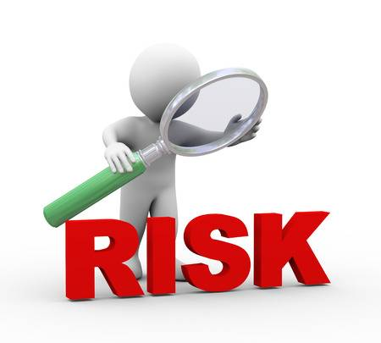
Risk is the effect of uncertainty on Objective
Opportunity
Issues

Slide 15
Risk-based thinking ensures risk is considered from the beginning and throughout the entire OHS Management System
Risk-based thinking makes preventive action part of strategic and operational planning

Slide 16
Risk Based Thinking is a central tenet of ISO 45001:2018

Slide 17
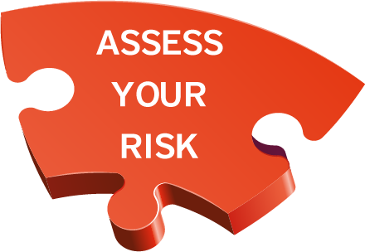
Risk Based Thinking = Preventative Action
Risk Based Thinking is everybody’s business!
Risk Based Thinking must become an integral part of the organizational culture
It…..
Ensures greater knowledge of risks and improves preparedness
Increases the probability of reaching objectives
Reduces the probability of negative results
Makes prevention a habit

Slide 18
How do I achieve a Risk Based Safety Cultures?

Slide 19
Take Ownership
1
Create
Ownership
And
Change
Happens
Develop clear objectives with meaningful programs

Slide 20
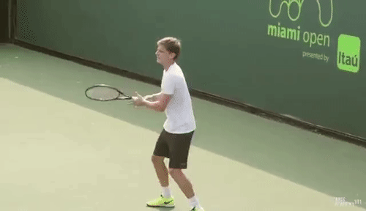
“Managing safety only by LTI, is like playing tennis with your eye on the scoreboard and not on the ball”…(Bernard Borg, 2002)

Slide 21
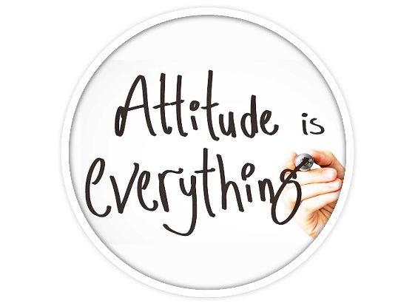
Learning Sessions and Engagement
2
Don’t forget the use of Lessons learnt from Incident
Everyone has a Zero Tolerance of Unsafe Behaviour

Slide 22
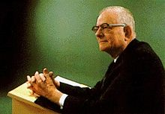
"People support what they help create."
W. Edwards Deming

Slide 23
“When you are looking at the person in the mirror, you are looking at the person responsible for your safety.”

Slide 25
Yellow/ Red Consequence Methodology
3

Slide 26
Develop Life Saving Rules and communicate effectively
Facilitate Counselling Sessions for Violators
Publish the Violators name
Celebrate Milestones and Share the Good News“….What Gets Celebrated Gets Done Well.”

Slide 27
….Finally

Slide 28
Risk Based Thinking
is about……
Leadership
Ownership
Prevention

Slide 29
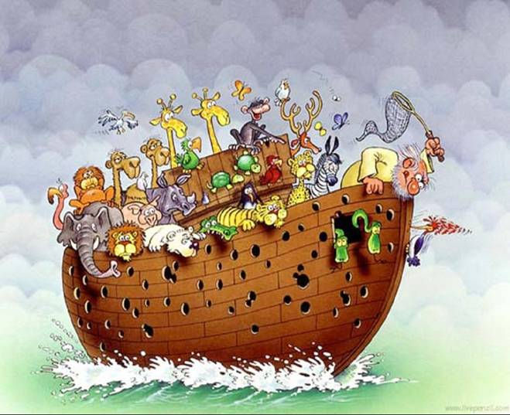
If you were in this boat, what would you do ?

Slide 30
A Prepared Organization is
a Safe Organization.

Slide 31
